Slide 1
Consumer and producer surplus
Chapter 4

Slide 2
Admin admin
Deadlines:
Thurs: LC4
Next Tues: HW4
Review session w/ Liv
Jeffords 127 Today 5–6
Thursday 4–5
Office hours Today 4:10–5:10
Old Mill 233 Wednesday 2–3
Notes:
https://PollEv.com/emilybeam001/register?group_key=V68rXzKvXeyig8S37oeYeEadG

Slide 3
Week 2 Agenda
Tuesday
What questions did you have about HW1 / HW3?
Review some tricky HW3 questions
Producer and consumer surplus
Thursday
- More review of demand shifts
- PS/CS
Notes:
https://PollEv.com/emilybeam001/register?group_key=V68rXzKvXeyig8S37oeYeEadG

Slide 4
Agenda
Review demand and supply shifts
Practice with consumer and producer surplus

Slide 5
Consumer and Producer Surplus
Chapter 4
Notes:
With a partner, discuss and be ready to share:
Are you in favor of legalizing the sale of kidneys? Why or why not?
Do you support the move to distribute organs in the United States based on “net benefit” rather than simply who’s been on the waiting list longest? Why or why not?

Slide 6
Today (Feb 11)
A reminder about Q8 on the HW
Review of calculating PS/CS
Discussion of shifting curves
Practice with PS/CS

Slide 7
Where are we?
We just covered twelve principles of economics (CH1) semi - asynchronously
We learned how to set up supply and demand curves and move them around (CH3).
We did the double shifts asynchronously

Slide 8
What questions do you have?
Help me help you
Throw in any general topics where you struggled
Any specific HW/LC questions you got stuck on?
Throw in any admin questions
Like/dislike anything that resonates with you

Slide 9
How is the pace so far?
Too slow
Just right
Too fast
🤷‍♀️

Slide 10
Plan
Today
- A bit of review/recap
Focus on opportunity cost
Work with some PS and CS
Thursday
- More review of demand shifts
- PS/CS

Slide 11
Opportunity cost
You’ve been dating Toby for two years. Toby is an extremely reasonable human and enjoys tacos, sledding, and sweet potatoes. Toby does not make your heart sing.
What is the opportunity cost of dating Toby?

Slide 12
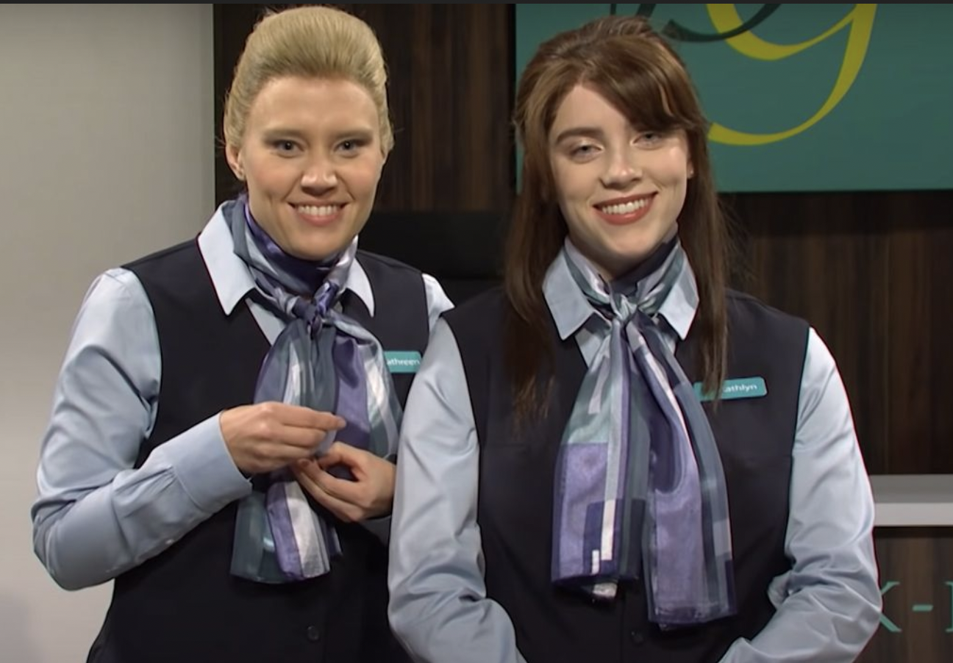
Opportunity cost, take 2
You bought a Groupon (HA, remember those?) to a spinning class. It expires today!
There is only one more spin class offered tonight at the gym, and but you had planned to watch Billie Eilish host SNL

Slide 13
What best represents the opportunity cost of the spin class?
Value of the spin class
Value of the spin class + enjoyment of SNL
No opportunity cost – you already paid for the class!
Enjoyment of SNL

Slide 14
Kidneys for sale
What would be the best way to regulate kidney donation in the US?
As is: voluntary w/ no compensation
Light modification: Allow coverage of medical expenses
Iran model: Allow cash payments within government regulated market
Free market: Buy and sell

Slide 15
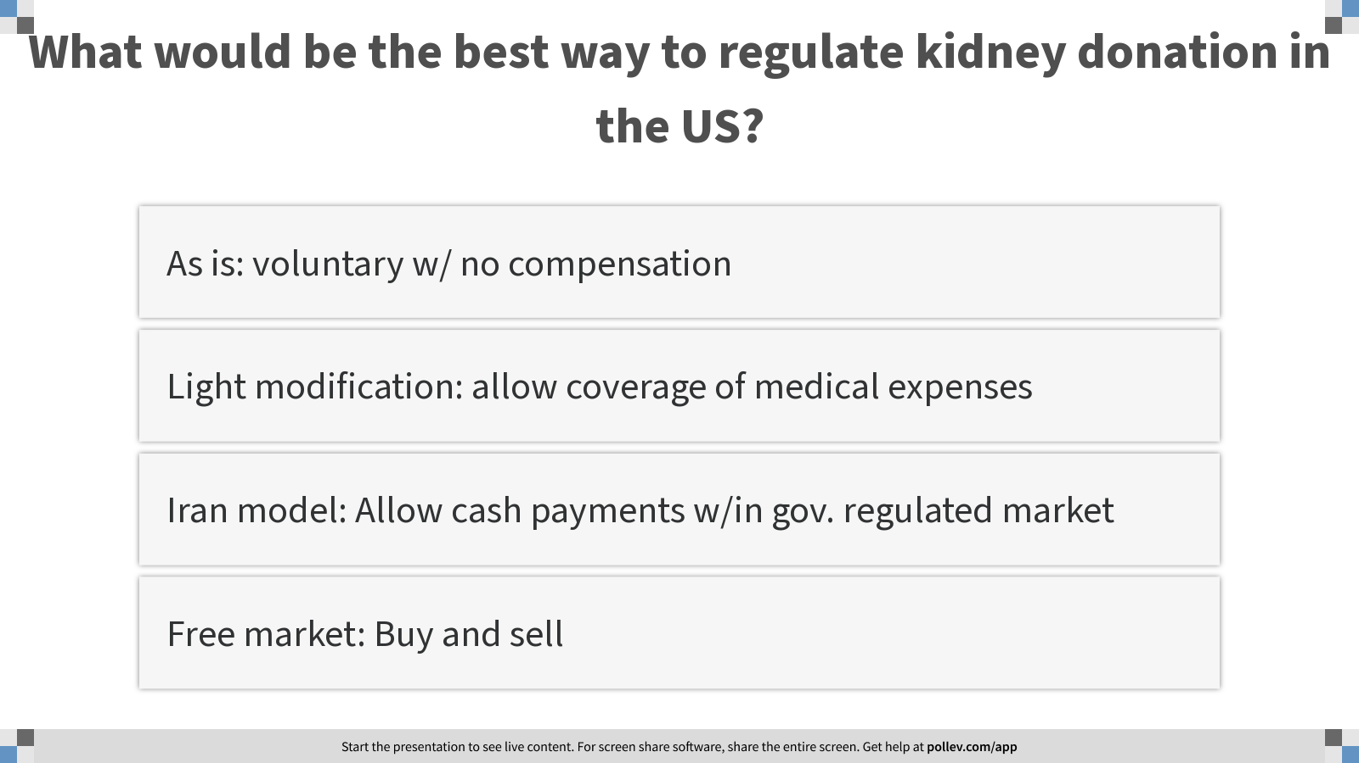
Notes:
What would be the best way to regulate kidney donation in the US?
https://www.polleverywhere.com/multiple_choice_polls/UwImTqCIMQ5i1QnVt7vtc?display_state=instructions&activity_state=opened&state=opened&flow=Engagement&onscreen=persist

Slide 16
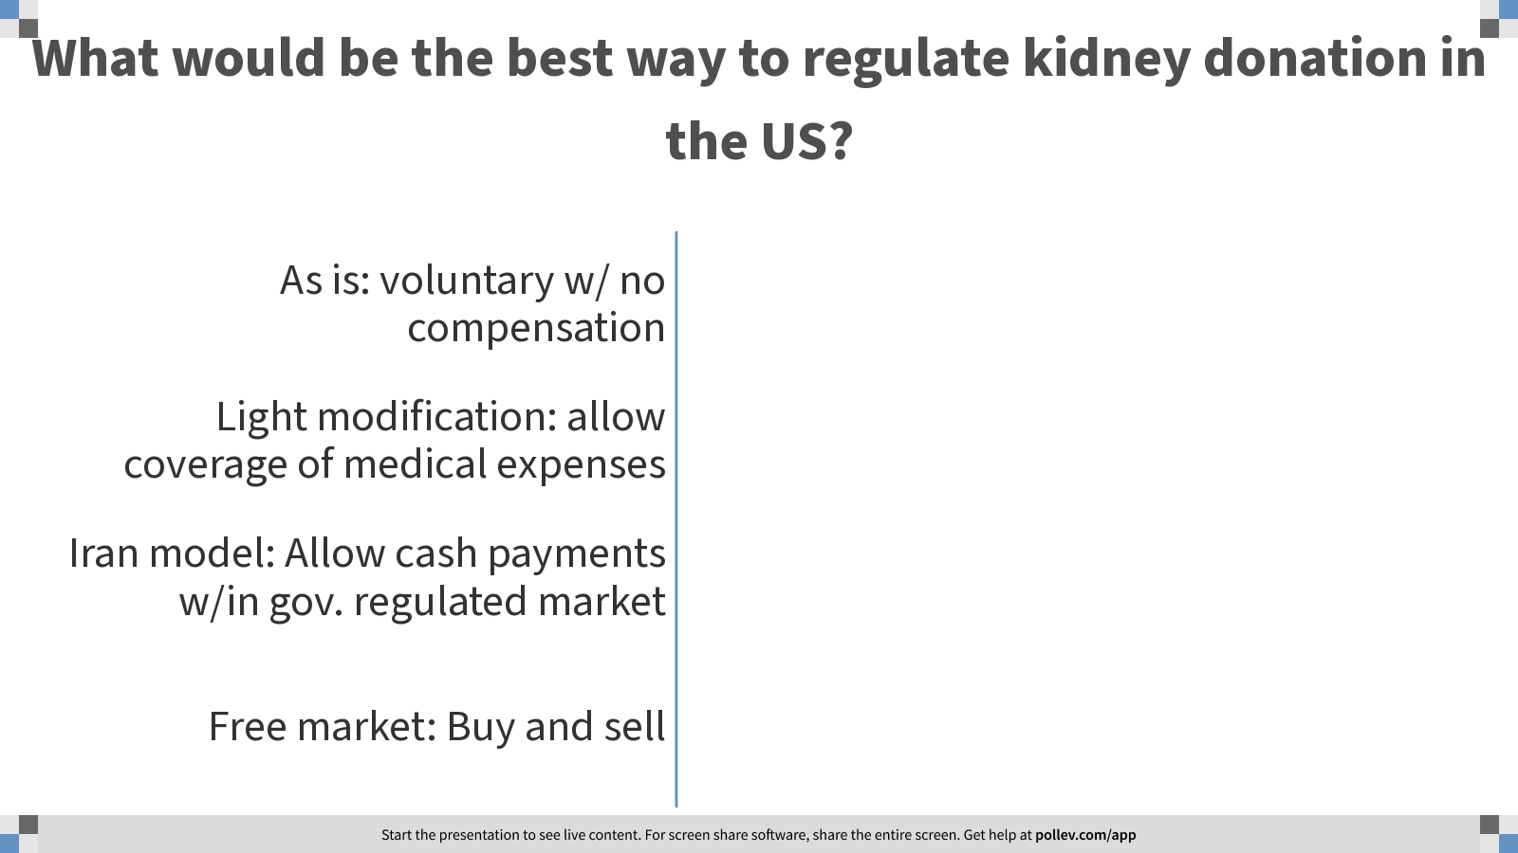
Notes:
What would be the best way to regulate kidney donation in the US?
https://www.polleverywhere.com/multiple_choice_polls/UwImTqCIMQ5i1QnVt7vtc?display_state=chart&activity_state=opened&state=opened&flow=Engagement&onscreen=persist

Slide 17

Notes:
What would be the best way to regulate kidney donation in the US?
https://www.polleverywhere.com/multiple_choice_polls/UwImTqCIMQ5i1QnVt7vtc?display_state=chart&activity_state=closed&state=closed&flow=Engagement&onscreen=persist

Slide 18
Public service announcement
How do you store your files/data/school work/etc.?
On my computer
On an external hard drive
On a cloud service (Dropbox, iCloud, GDrive, Box, etc.)
Something else
I DESTROY ALL THE EVIDENCE

Slide 19
Learning objectives
Calculate consumer and producer surplus
Define and identify deadweight loss
When markets lead to efficiency
Types of market failures

Slide 20
SURPLUS
CONSUMER
& PRODUCER
Buyer’s maximum willingness to pay (WTP)
$20,000
CONSUMER SURPLUS
$
$
$
$
$
$
$
$
Consumer surplus (WTP – Price) = $2,800
Negotiated price = $17,200
PRODUCER SURPLUS
Producer surplus (Price – WTS) = $2,200
$15,000
Seller’s minimum willingness to sell (WTS)
SLIDE 20
Notes:
CONSUMER SURPLUS IS A FORM OF SAVING BECAUSE CONSUMERS ARE WILLING TO PAY MORE THAN THE MARKET PRICE.
PRODUCER SURPLUS IS A FORM OF EARNING BECAUSE BUSINESSES ARE WILLING TO PROVIDE A GOOD OR SERVICE BELOW THE MARKET PRICE.

Slide 21

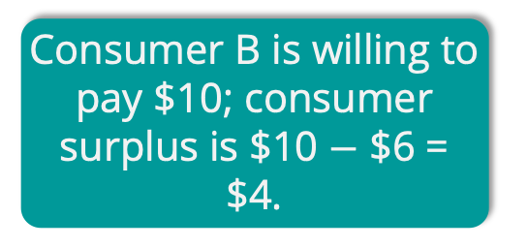
INDIVIDUAL CONSUMER SURPLUS
Consumer A is willing to pay $11...
P
12
S₀
11
10
Consumer A’s surplus is $11 $−$ $6 = $5.
9
8
7
6
Consumer B is willing to pay $10; consumer surplus is $10 $−$ $6 = $4.
…but the price is just $6.
D₀
And so on…
Q
0
1 2 3 4 5 6
SLIDE 21

Slide 22
TOTAL CONSUMER SURPLUS
P
12
S₀
11
10
The sum of all individual consumer surplus
9
8
consumer surplus
7
6
The area below the demand curve and above the price
D₀
Q
0
1 2 3 4 5 6
SLIDE 22

Slide 23
Buy some new shirts, George!
George wants to buy some new shirts for work. He is willing to pay $35 for the first shirt, $25 for the second shirt, and $15 for the third.
Oxford & Co. (his favorite shirt shop!) sells shirts for $28 each.
What is the efficient number of shirts for George to buy?
0
1
2
3
Notes:
What is his consumer surplus?

Slide 24
Buy some new shirts, George!
George wants to buy some new shirts for work. He is willing to pay $35 for the first shirt, $25 for the second shirt, and $15 for the third.
Oxford & Co. (his favorite shirt shop!) sells shirts for $28 each.
What is George’s consumer surplus?
$0
$7
$10
$28
$35
Notes:
What is his consumer surplus?

Slide 25
Calculating consumer surplus
Mark and Rasheed are buying new calculators for Math 19. Mark is willing to pay $75 and Rasheed is willing to pay $100 for a graphing calculator. The price for a calculator at the bookstore is $65. How much is their total consumer surplus?
$10
$35
$45
$60
Notes:
Answer: $45

Slide 26
If the price of hamburgers is $2, consumer surplus will equal:
$650
$400
$225
$450
Notes:
Answer: $225

Slide 27
If the price of hamburgers is $2.50 today, what will happen to the price in the coming days/months?
It will fall
It will rise
It will remain the same
Not enough information

Slide 28
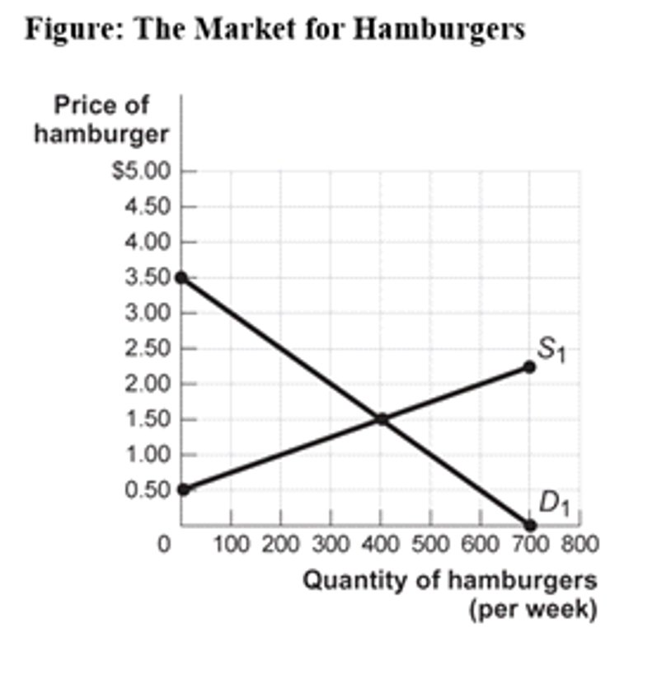
If the price of hamburgers rises, what will be the main effect on the chart?
Supply will shift left
Supply will shift right
Demand will shift left
Demand will shift right

Slide 29
If the price of a hamburger is $2, consumer surplus will be …
$650
$450
$400
$225

Slide 30


INDIVIDUAL PRODUCER SURPLUS
P
S₀
The price is $6…
Producer A’s surplus is $6 $−$ $2 = $4.
6
Producer B is willing to sell at $3; producer surplus is $6 $−$ $3 = $3.
5
4
…but producer A is willing to sell at $2.
3
2
And so on…
D₀
1
Q
0
1 2 6
SLIDE 30

Slide 31
Four different students each have one textbook they might sell back to the bookstore. Below is each student’s reservation price: the lowest price at which they would be willing to sell the book.
The bookstore is buying textbooks at a price of $25.
Seller | Seller’s Reservation Price
Alex | $12
Piper | $16
Daya | $22
Red | $30
How many students will sell their textbooks?
0
1
2
3
4

Slide 32
TOTAL PRODUCER SURPLUS
P
S₀
The sum of all individual producer surplus
6
The area above the supply curve and below the price
producer surplus
1
D₀
Q
0
6
CHAPTER 4
SLIDE 32

Slide 33
If 400 hamburgers are sold, producer surplus will equal
$650
$400
$510
$200
Notes:
Answer: $200

Slide 34
If the price falls from $1.50 to $1, what is the loss in producer surplus?
$50
$45
$150
$200
Notes:
Answer: $150

Slide 35
TOTAL SURPLUS
When markets are efficient, TS is MAXIMIZED!
TS = CS + PS
Notes:
Total surplus is maximized with markets: Markets are efficient.
Three ways you might (unsuccessfully) try to increase the total surplus
reallocate consumption among consumers
reallocate sales among sellers
change the quantity traded

Slide 36
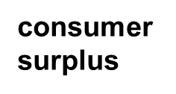
WHEN PRICES EXCEED EQUILIBRIUM
Price rises to $400; quantity falls to 10.
P
S₀
400
New consumer surplus
300
Transferred to producers
producer surplus
Deadweight loss
D₀
Q
0
10
20
SLIDE 36

Slide 37
WHEN PRICES ARE BELOW EQUILIBRIUM
Price falls to $200; quantity falls to 10.
P
S₀
Deadweight loss
300
Transferred to consumers
producer surplus
200
New producer surplus
D₀
Q
0
10
20
SLIDE 37

Slide 38
If the price of hamburgers is $2, consumer surplus will equal:
$650
$400
$225
$450
Notes:
Answer: $225

Slide 39
If the price of hamburgers is $2.50 today, what will happen to the price in the coming days/months?
It will fall
It will rise
It will remain the same
Not enough information

Slide 40
If the price of hamburgers rises, what will be the main effect on the chart?
Supply will shift left
Supply will shift right
Demand will shift left
Demand will shift right

Slide 41
If the price of a hamburger is $2, consumer surplus will be …
$650
$450
$400
$225

Slide 42
If 400 hamburgers are sold, producer surplus will equal
$650
$400
$510
$200
Notes:
Answer: $200

Slide 43
If the price falls from $1.50 to $1, what is the loss in producer surplus?
$50
$45
$150
$200
Notes:
Answer: $150

Slide 44
Look at the market for octopus candle holders. What is producer surplus at equilibrium?
$1000
$2000
$4000
$8000

Slide 45
Look at the market for octopus candle holders. What is total surplus at equilibrium?
$1000
$2000
$4000
$8000
Notes:
2000

Slide 46
Amazon caps the price at $15. What is the new producer surplus?
$1125
$1875
$2000
$2250

Slide 47
Efficiency of Markets
Competitive markets are usually efficient:
Allocate consumption to the potential buyers who most value it.
Allocate sales to potential sellers who most value right to sell the good (e.g., who have the lowest cost).
They ensure that all transactions are mutually beneficial
Notes:
Mutually beneficial Every consumer who makes a purchase values the good more than every seller who makes a sale.

Slide 48
Why markets typically work so well
Well-functioning markets are effective because of:
Property rights: the rights of owners of valuable items, whether resources goods, to use those items as they chooseor.
Economic signals: any piece of information that helps people make better economic decisions.
Notes:
Prices translate complex information into an easy signal for producers:
Profits rise in industries when consumers want more of that industry’s products.
Profits decline in industries when consumers want less of that industry’s products.
The high price of ice in post-Katrina New Orleans made it more attractive for firms to provide ice where society needed it most.

Slide 49
Four sources of market failures
Markets will not be efficient in the presence of market failures!
Lack of competition
Information not shared by all parties
Existence of external benefits/costs (externalities)
Existence of public goods

